Slide 1
Overview of the Basic Structure of C++

Slide 2
Contents
Simple Programs
New Things in C++
Pointers and Memory Allocation

Slide 3
A Simple Program
// A Simple Hello, World Program
#include <iostream.h>
main()
{
/* the output statement */
cout << “Hello, World!”;
}//ex2hello.cpp

Slide 4
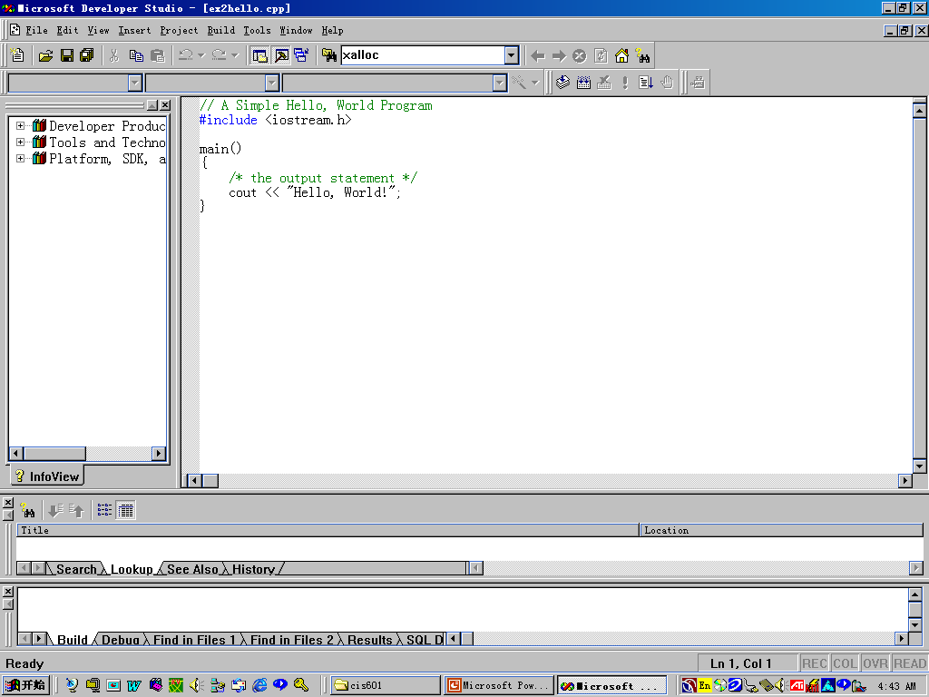

Slide 5
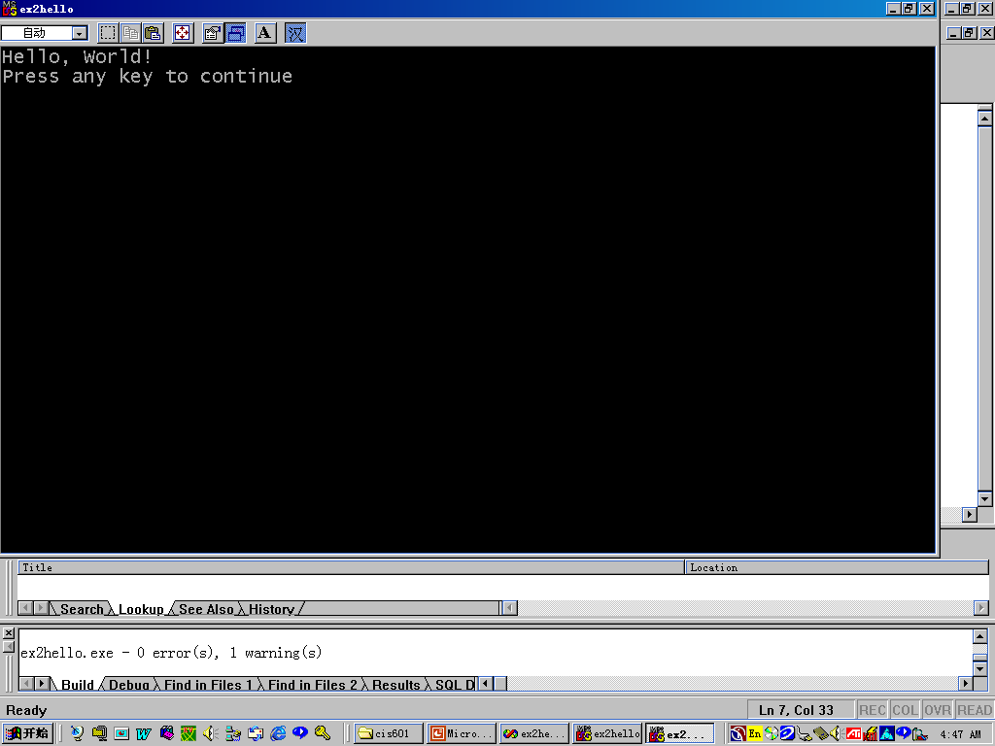

Slide 6
Function Prototype
void Do_Task(int a, float b);
main()
{int x = 5;
float y = 10.65;
Do_Task(x, y);
}
void Do_Task(int a, float b)
{cout <<a+b<<‘\n’ ;}//ex2func.cpp

Slide 7
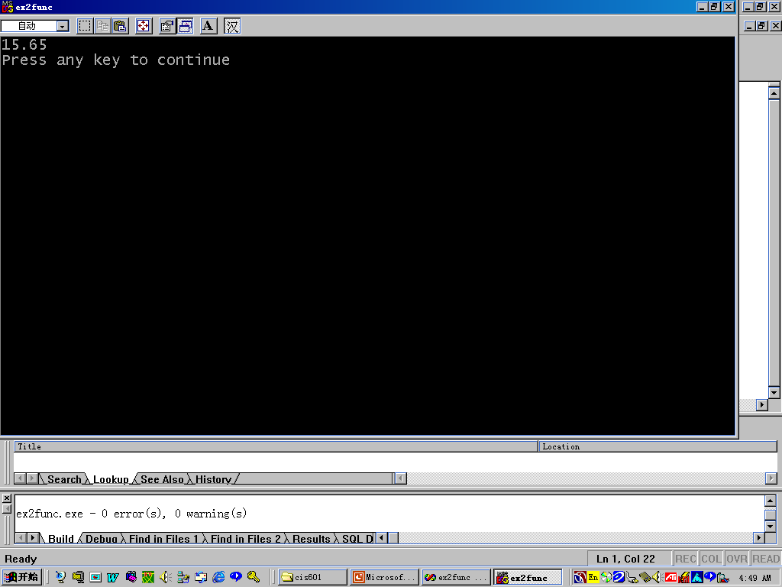

Slide 8
Declarations and Definitions
A Declaration introduces an identifier into a program and states its attributes.
A Definition does everything a declaration does, and more.
A variable definition or a function definition allocates program storage. But a declaration does not.

Slide 9
Example
definitions
int n;
int sum (int a , int b) { return a+b;}
const long count = 0;
extern int n;
int sum(int a, int b);
extern long count;
declarations

Slide 10
Definitions of structures, enumerated constants, and classes Do Not Allocate Storage.
struct Z {float r};
enum {up, down};
Class Student{long id;
char lastname[30];
}

Slide 11
Storage Duration
automatic storage duration
  void sub() {int n;
  auto int m; }
Static storage duration
  Example:static.cpp
Dynamic storage duration
  new and delete

Slide 12
Parameters and Arguments
Parameters: the member + the type.
  int f(int x) {//…}
Arguments: the member in the calling
  f(m)

Slide 13
Call By Value
#include <iostream.h>
void increment(int)
main()
{
int i=2;
increment(i);
cout << “i = “ << i;
}
void increment(int x) { x++; }//ex2callbyval.cpp

Slide 14
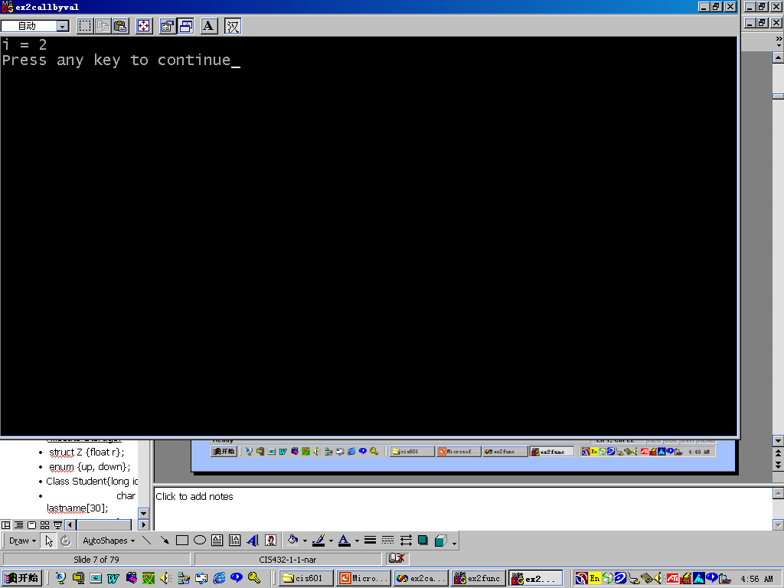

Slide 15
Call By Reference
#include <iostream.h>
void increment(int &)
main()
{
int i=2;
increment(i);
cout << “i = “ << i;
}
void increment(int& x) { x++; }//ex2callbyref.cpp

Slide 16
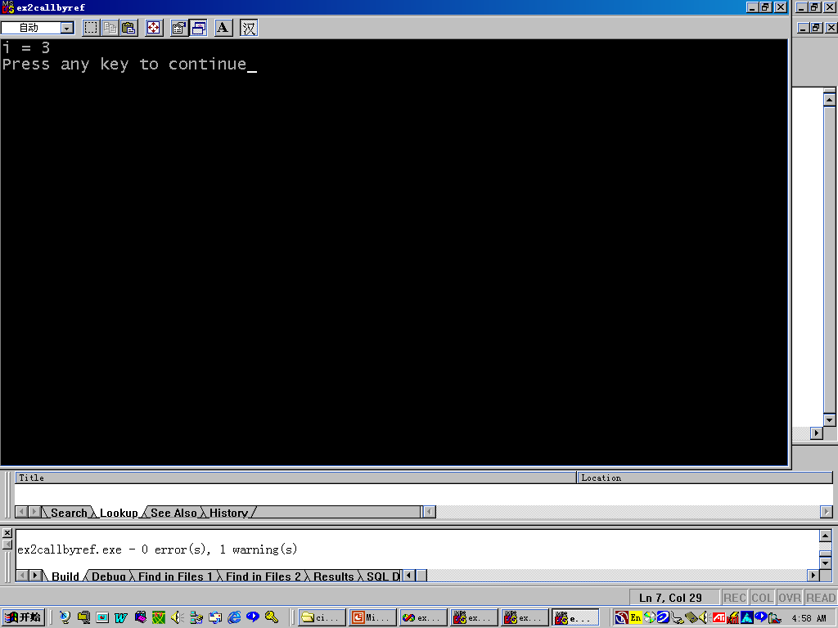

Slide 17
Constant Reference Parameter
void fun(const int & x)
{
...
}
“x” is passed by reference (efficiency) while maintaining the security of a call-by-value.//ex2callbyrefc.cpp

Slide 18
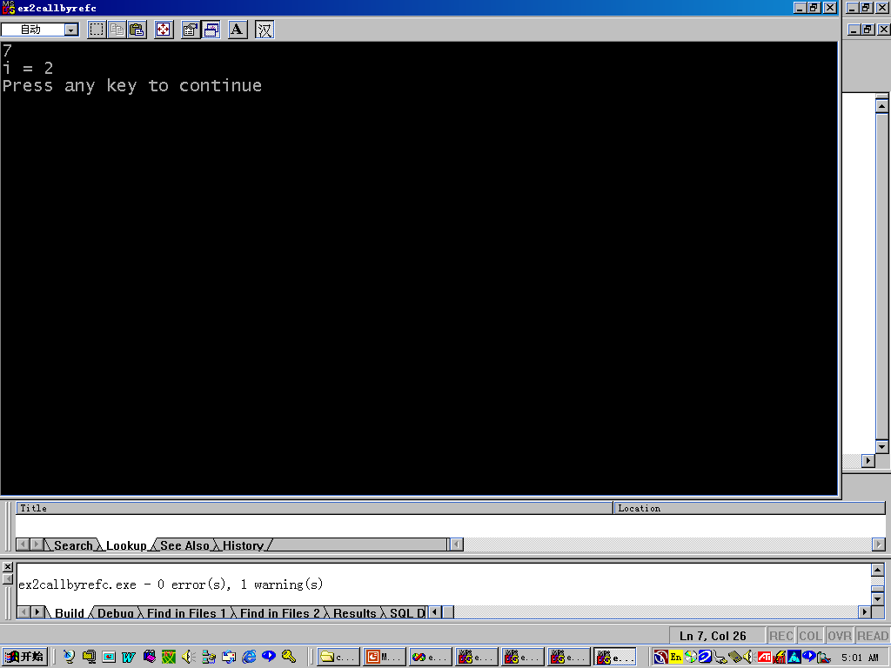

Slide 19
Default Arguments
Parameters can be assigned default values.
Parameters assume their default values when no actual parameters are specified for them in a function call.

Slide 20
Example
// Find the sum of numbers in a range of values
// Between “lower” and “upper” using increment “inc”
int sum( int lower, int upper=10, int inc=1)
{
int sum=0;
for(int k=lower; k<=upper; k+= inc)
sum += k;
return sum;
} //ex2defaultarg.cpp

Slide 21
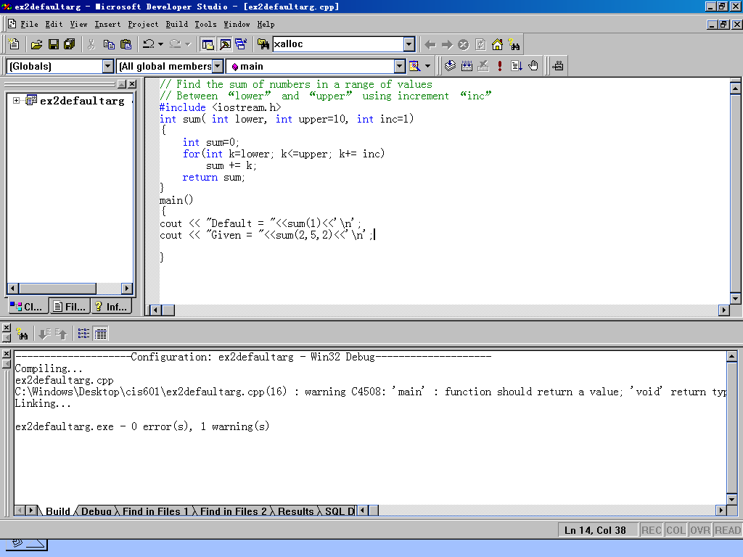

Slide 22
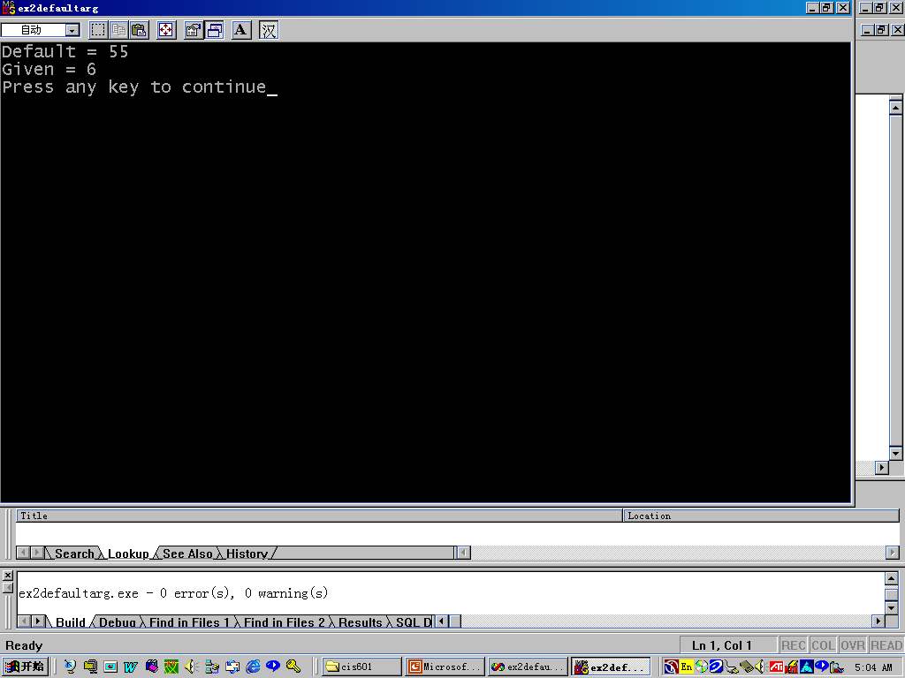

Slide 23
New Things in C++
New Keywords
Cast operator
Functions
Type-safe linkage
Linking to C functions

Slide 24
New Keywords
asm, bool, catch, class, const_cast, delete, dynamic_cast, explicit, false,friend, inline, mutable, namespace, new, operator, private, protected, public, reinterpret_cast, static_cast, template, throw, true, try, typeid, typename, using, virtual, wchat_t, …
bitand, and, bitor, or, xor, compl, ane_eq, or_eq, xor_eq, not, not_eq
“__” and “_C” are reserved in C++, do not use these as identifiers

Slide 25
New Keywords
Comments: /*…*/ or //
char for characters: int n += ‘a’;
Variables may be defined everywhere before you use.
  …
  float sum = 0.0;
  for (int k =0; k<count; k++; )
  sum +=array[k]
  …..

Slide 26
Cast operator
float g = (float) i/2;
float g = float ( i ) /2;
BUT:
  void *v;
  float *f;
  …
  f = v; //error;
  f = (float *) v; //ok, explicit casting for pointer

Slide 27
Functions
In C++, you must at first declare (or define) and then call.
The function name and its argument type must be consistent with the declaration or definition.

Slide 28
Linkage
Type-safe linkage
  The linker checks for consistency between the call and the definition.
Linking to a C function
  extern “C” must be used to link a C function.

Slide 29
C++ Features
Named Constants
Enumerated Constants
Reference Parameters
I/O Streams

Slide 30
Named Constants
Only one method in C:
  #define ArraySize 100;
Another way in C++:
  const ArraySize =100;
Again in C++:
  constant can be used in local scope.
const is used when a value cannot be changed.

Slide 31
Named Constants
C/C++ Differences in using constants
  extern const int count = 5; //extern //linkage
  static const float average = 0.5; //internal //linkage
  const float f; //error!, invalid!
  extern const float f; //ok, extern linkage
  const int count = 100; //ok, internal //linkage

Slide 32
Enumerated Constants
Without tag:
  enum {red, yellow, blue};
  int wincolor = red;
With tag:
  enum priColors {red, yellow, blue};
  priColors wincolor;
  wincolor = red; //ok
  wincolor = 0; //error

Slide 33
Enumerated Constants
enum tag_name{enum_list};
  enum {running, standby, offline, inoperative}
  enum {running=0, standby=99, offline=50, inoperative=10}

Slide 34
enum const
const int idSize = 7;
const int nameSize = 30;
Class Student {
//…
private:
char id[idSize+1];
char name[nameSize +1];
}

Slide 35
enum const
Class Student {
//…
private:
enum {idSize =7, nameSize =30};
char id[idSize+1];
char name[nameSize +1];
}

Slide 36
Tag Names
enum TStatus {running, standby, offline, inoperative}
TStatus currentStatus;
currentStatus = running; //ok
currentStatus = 1; //error
int n = currentStatus;
unsigned x = standby;
float f = inoperative;

Slide 37
Reference Parameters
A reference parameter is a function parameter that is an alias for the corresponding argument passed to the function.
Examples:
  ex2ref.cpp and ex2refc.c

Slide 38
ex2ref.cpp
#include <iostream.h>
void swap(int &x, int &y)
{
int temp = x;
x = y;
y = temp;
}
main()
{ int a = 10, b = 20;
swap(a,b);
cout << "a = " <<a<< ", b = "<<b << "\n";
}

Slide 39
ex2refc.c
#include <stdio.h>
void swap(int *x, int *y)
{
int temp = *x;
*x = *y;
*y = temp;
}
main()
{ int a = 10, b = 20;
swap(&a,&b);
printf("C version: a = %d, b = %d \n ",a,b);
}

Slide 40
I/O Streams
A stream is a sequence of bytes that may be either input to a program or output from a program.
cin, cout, and cerr are three standard devices for input (keyboard), output and error output (tied to the screen).
iostream.h (or .hxx, or hpp)should be included.

Slide 41
Stream I/O
Buffered(cin, cout), unbuffered(cerr)
Buffered characters should be flushed.
Unbuffered characters can be seen immediately.

Slide 42
Stream Output
<< operator, by default formats
int n;
cout<<n;
float f;
cout<< f;
File: ex2cout.cpp

Slide 43
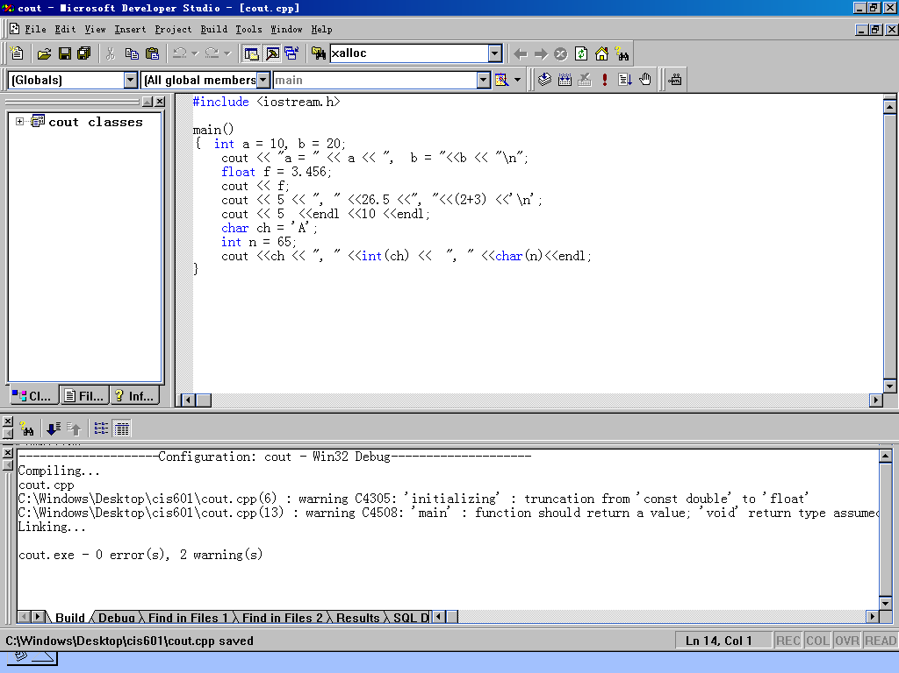

Slide 44
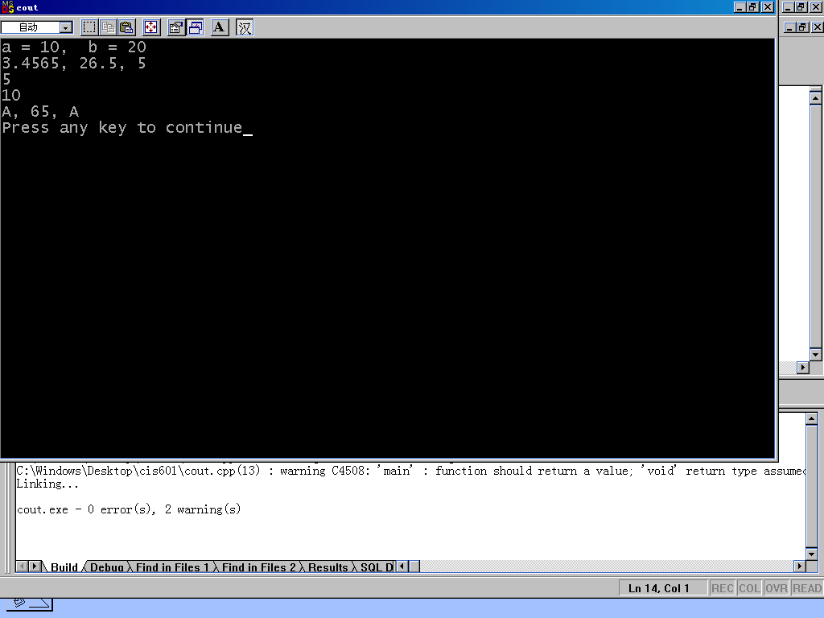

Slide 45
Input Stream
>> operator
int n;
cin >>n;
Skip whitespace, eg. Spaces, tabs, and newlines.
Example: ex2cin.cpp

Slide 46
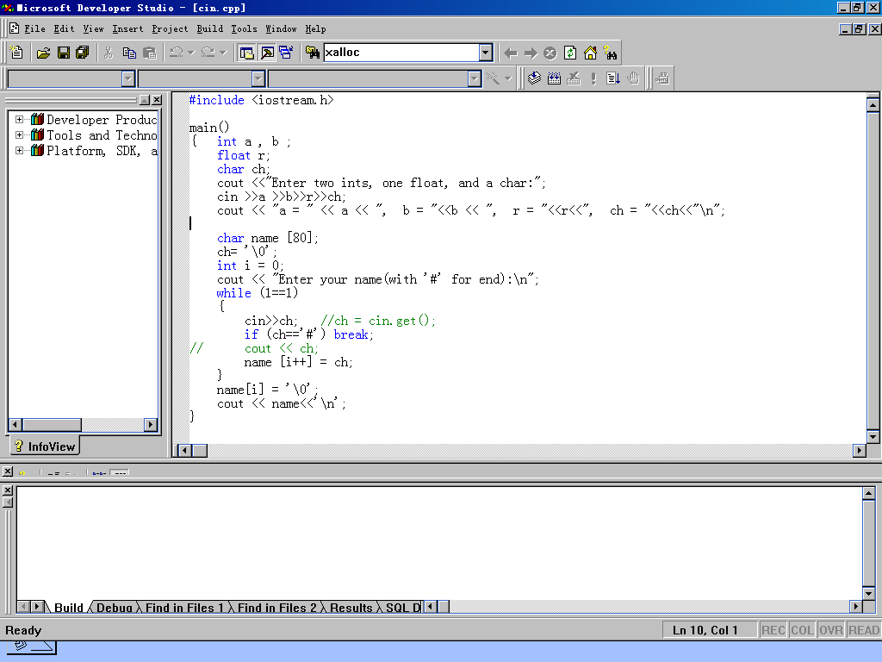

Slide 47
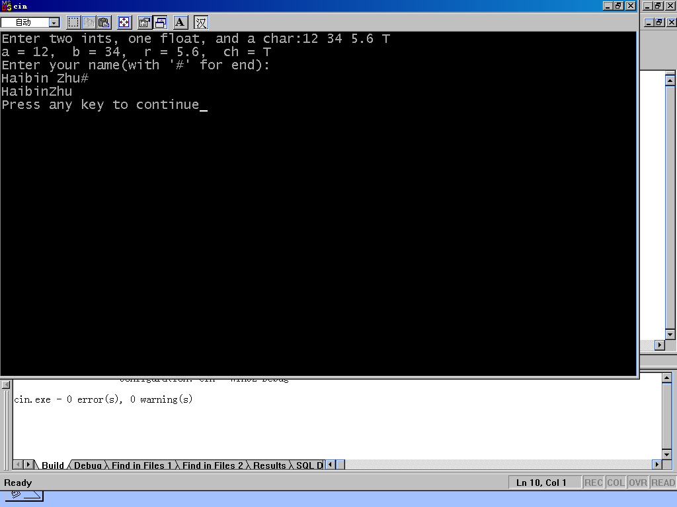

Slide 48
Pointers and Dynamic Memory Allocation
Constant Pointers
Pointer Conversions
Allocating Memory
Arrays and Dynamic Allocation

Slide 49
Constant Pointers
The object can not be modified when this pointer used for access.
int n = 0;
const int * cp = &n;
* cp = 30; // Error!
n = 30; //OK!
//ex2constp.cpp

Slide 50
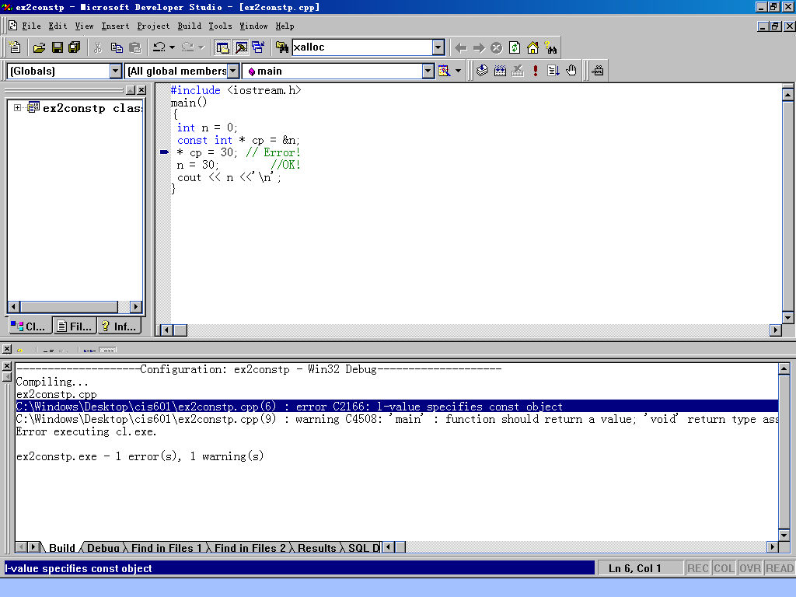

Slide 51
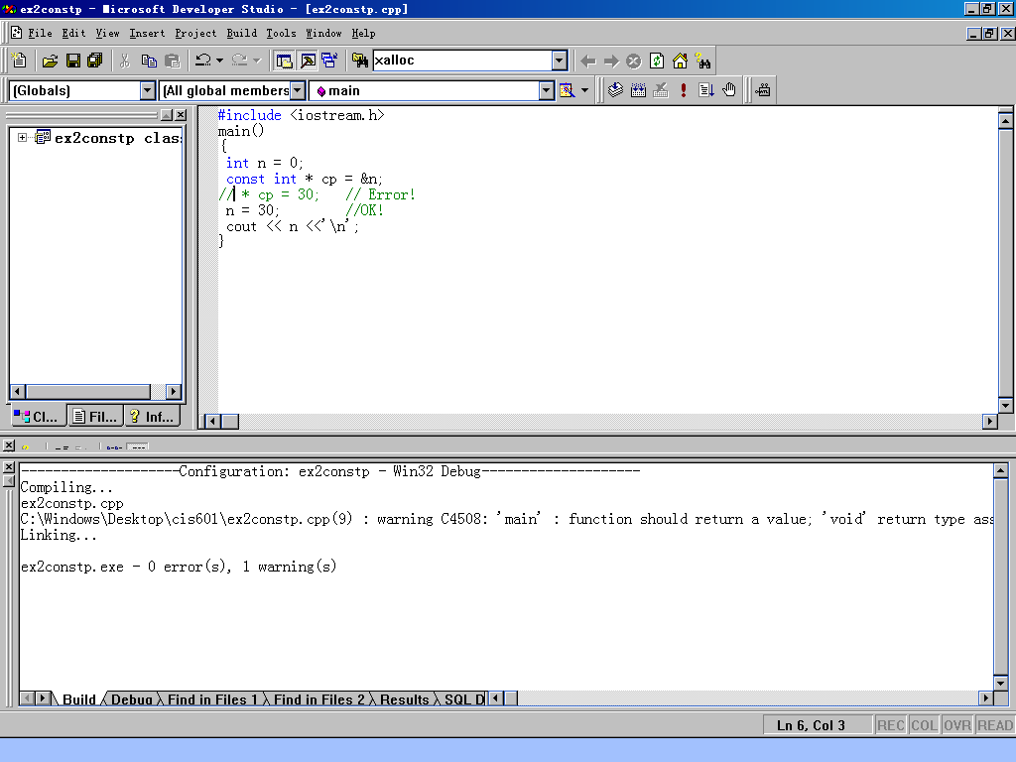

Slide 52
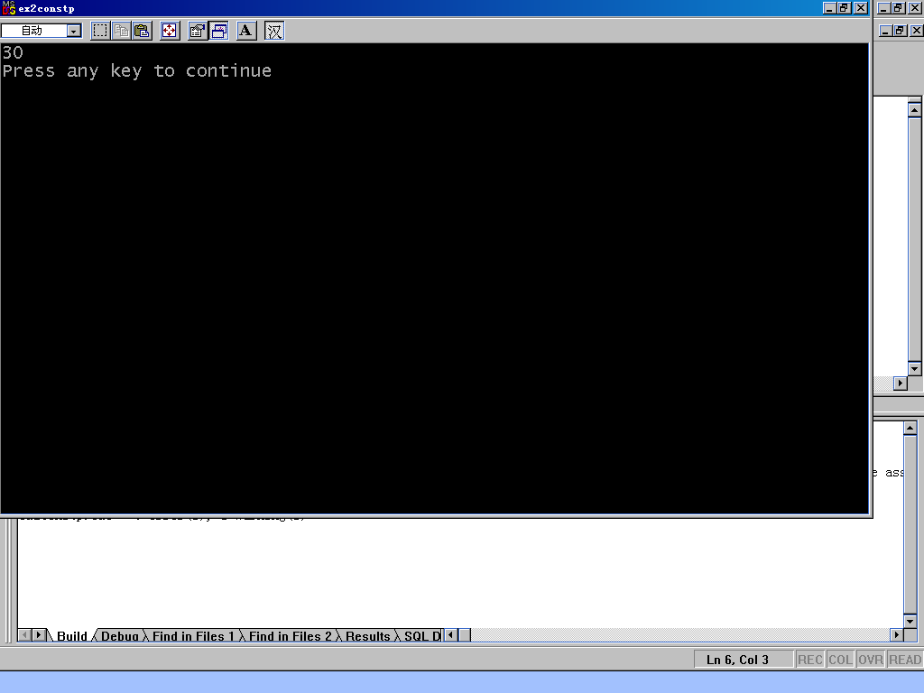

Slide 53
Constant Pointers
The same for parameters
  size_t strlen(const char * str)
  const char * aStr = “ABCDEFG”;
  char name [] = “Johnson”;
  unsigned n;
  n = strlen(aStr);
  n = strlen(name);
Cannot pass a pointer to a constant to a function with a parameter that is a pointer to a non-constant

Slide 54
Example
char * strcpy(char * dest, const char * source);
…
const char * des;
const char * sou;
strcpy(des, sou); //error!

Slide 55
Const-Qualified Pointers
char message[80];
char *cost sp = message;
sp++;
strcpy(sp, “A new message”);
//error
//OK

Slide 56
Const-Qualified Pointers
char message[80];
const char *cost sp = message;
sp++;
strcpy(sp, “A new message”);
//ex2cqptr.cpp
//error
//error

Slide 57
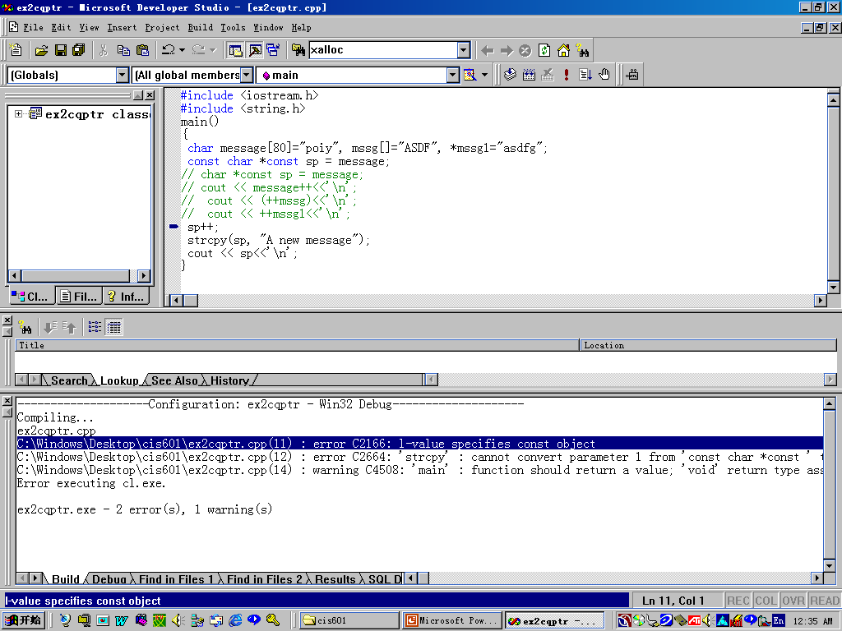

Slide 58
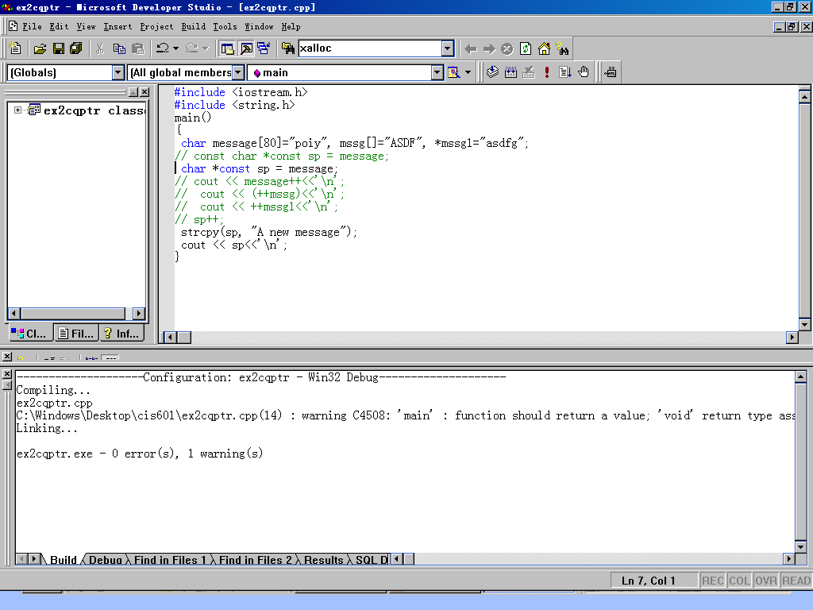

Slide 59
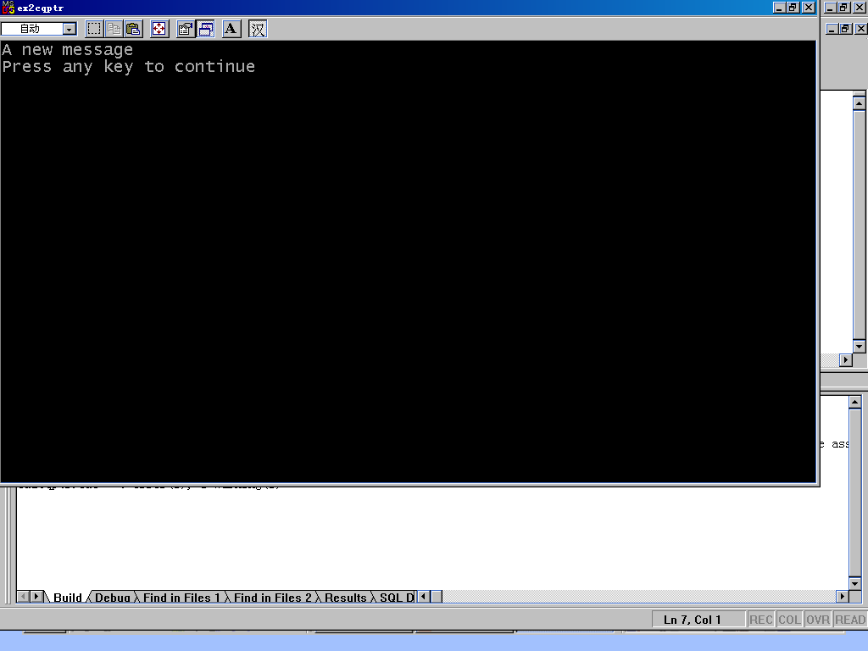

Slide 60
Four ways to declare a pointer
char *p1 = message;
char *const p2 = message;
const char *p3 = message;
const char const *p4 = message;

Slide 61
Functions returning Pointers to Constants
The variable receiving the returned value should also be a pointer to a constant.
class Student{
public:
const char * GetName() const;
// …
}

Slide 62
Functions returning Pointers to Constants
Student s;
char * ncName = S.GetName();
const char * cName = S.GetName();
//error
//OK

Slide 63
Pointer Conversions
Pointers to Array Elements
Void Pointers
References to Pointers

Slide 64
Pointers to Array Elements
Pointer is related to a type or a class.
The pointer pointing to an array can be incremented and decremented.
float flist[] = {10.3, 13.2, 4, 9.6};
float * fp = flist;
fp++;
cout<<fp;
//ex2ptrarray.cpp

Slide 65
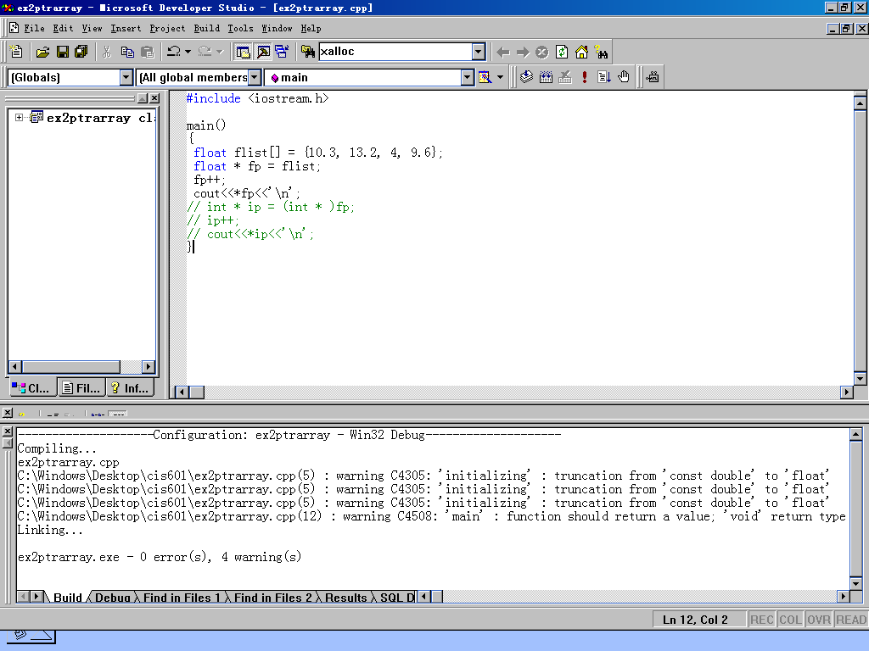

Slide 66
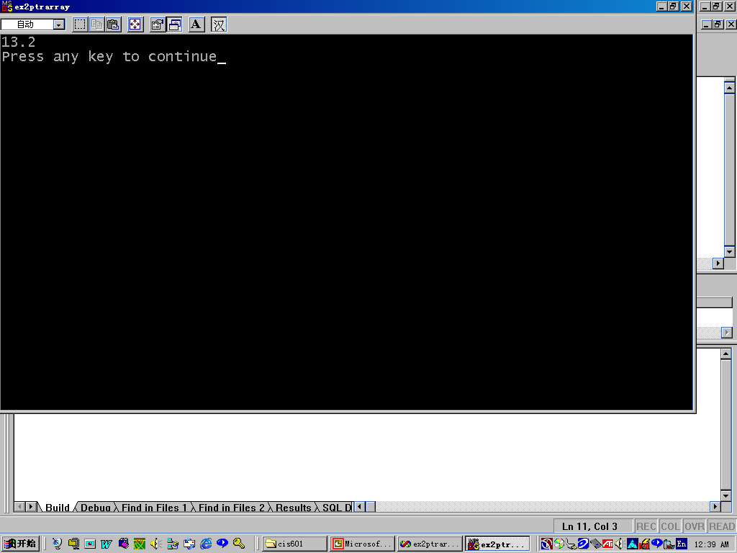

Slide 67
Pointers to Array
float flist[] = {10.3, 13.2, 4, 9.6};
float * fp = flist;
int * ip = (int * )fp;
ip++;
cout<<*ip;//ex2ptrarrayint.cpp
//The result is the integer value
//transformed from the float value

Slide 68
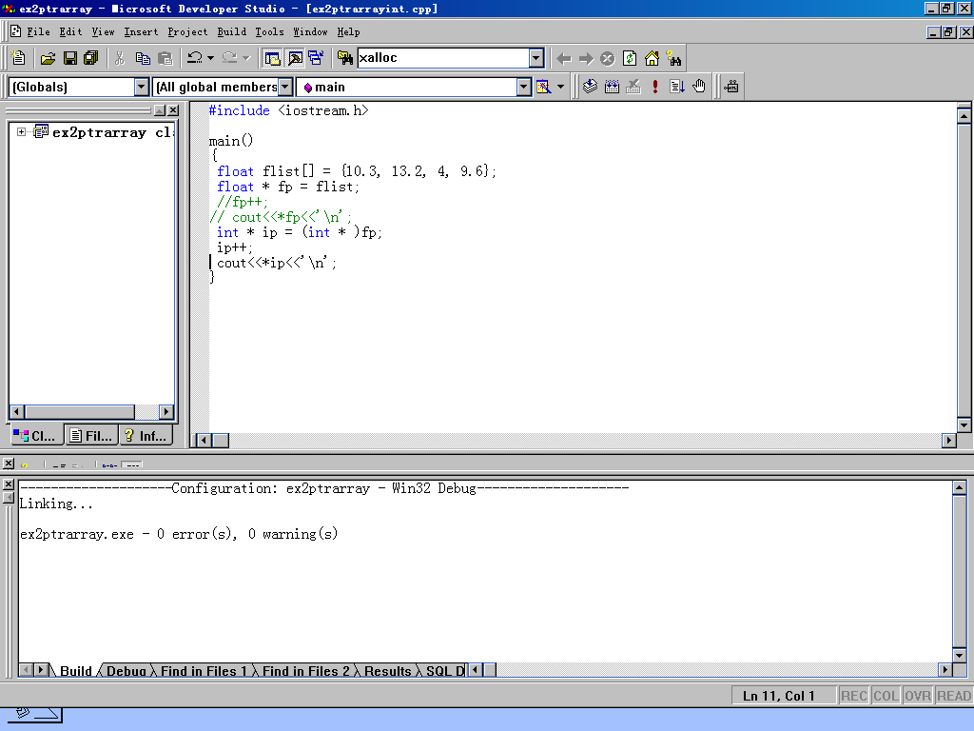

Slide 69
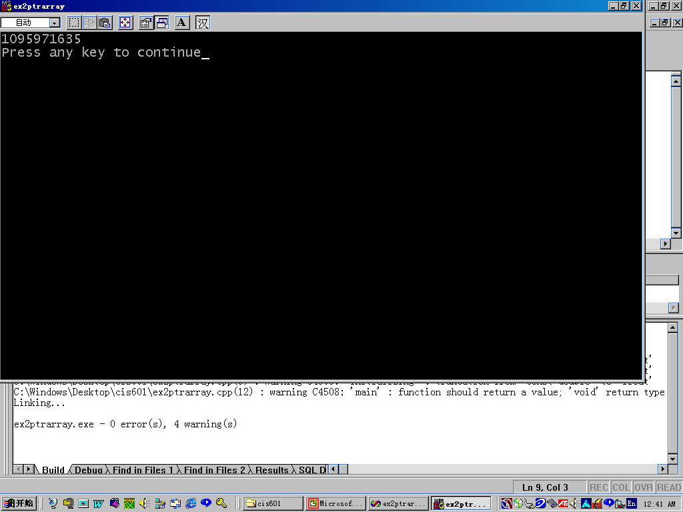

Slide 70
Void Pointers
To obtain flexibility of types
void * memcpy ( void *dest, const void * src, size_t nbytes)
const unsigned ArraySize = 500;
long arrayOne[ArraySize];
long arrayTwo[ArraySize];
memcpy (arrayOne, arrayTwo, ArraySize* sizeof(long));

Slide 71
Void Pointers
Casting required
int *p;
void *v = p;
p = (int *) v; //cast needed

Slide 72
References to Pointers
#include <iostream.h>
void FindNext( char * & p, char delim )
{ while( *p && (*p != delim) )
p++;}
int main()
{char str[] = "abc,def,ghi,jkl";
for(char * p = str; *p; p++)
{ FindNext( p, ',' );
cout << p << endl;}
return 0;
} //ex2refptr.cpp

Slide 73
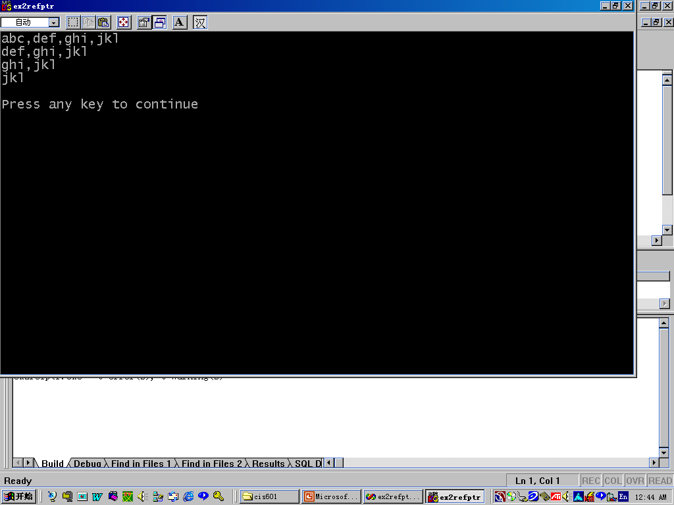

Slide 74
Allocating memory
Static and Dynamic Allocation
  Allocating memory for objects at compile time-- Static Allocation
  Allocating memory for objects at run time-- Dynamic Allocation

Slide 75
Static and Dynamic Allocation
Deallocating storage refers to releasing a block of memory whose address is in a pointer variable--deleting a pointer.
Fragmentation: is the condition where enough objects have been allocated and deallocated from the heap so that gaps occur between allocated objects.

Slide 76
The new Operator
The new operator is used to allocate memory dynamically
  int* p;
  p = new int;
  *p = 10;
  int * array = new int[50];
p
NULL
p
p
10

Slide 77
The delete Operator
The delete operator is used to deallocate memory space (created dynamically)
  delete p;
  delete [] array;

Slide 78
Allocating a Vector of Storage
int* p = new int [5] ;
for (int j=0; j < 5; ++j)
*(p + j) = 10 * j;
for ( j=0 ; j < 5; j++ )
cout << p[ j ];
delete [] p;
//ex2new.cpp
0
p
10
20
30
40

Slide 79
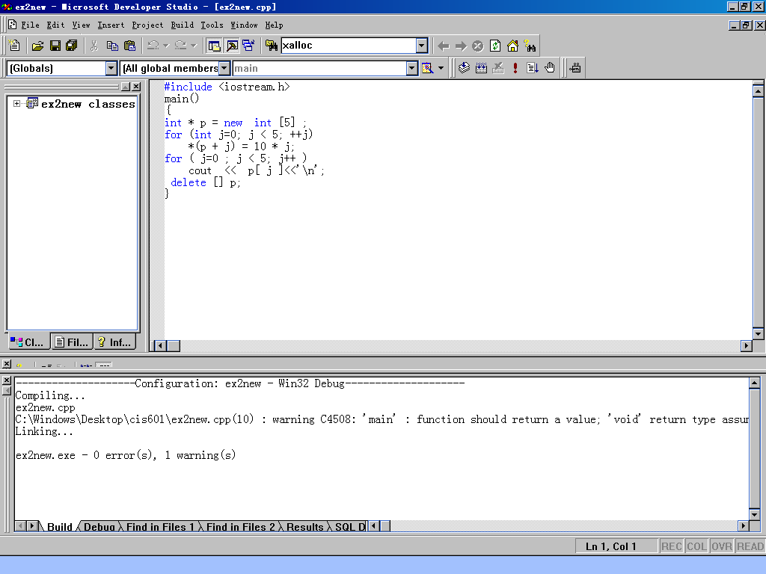

Slide 80
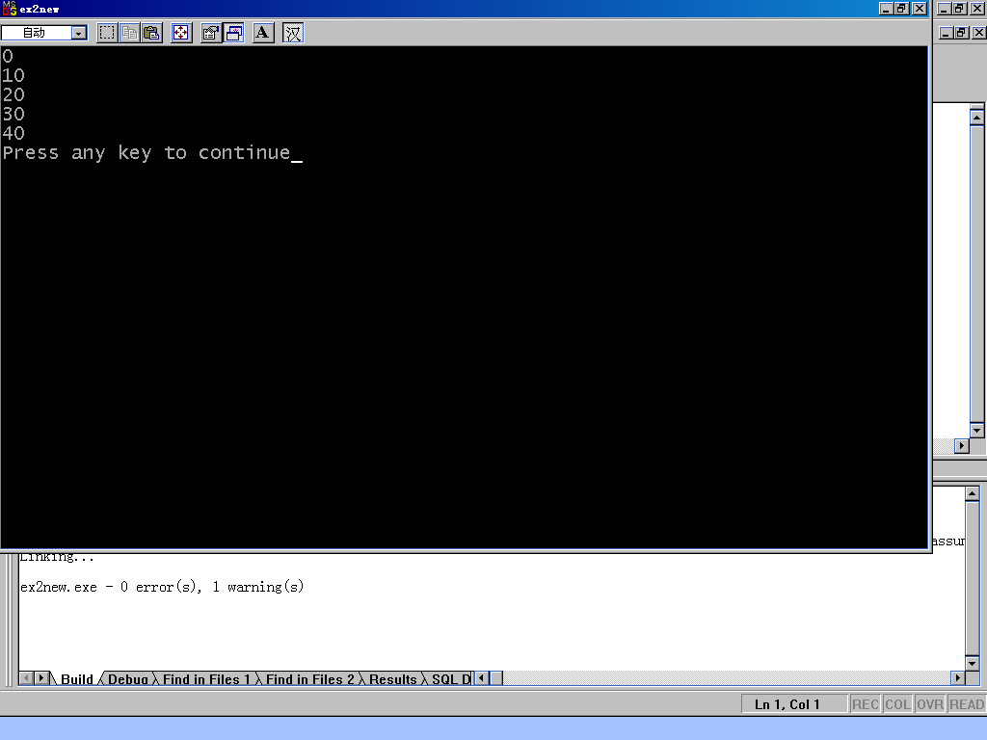

Slide 81
Storage Duration and Pointers
the storage duration of a pointer itself and the memory that it addresses are distinct issues.
if (a>b)
{float *fp = new float;} //temporary in //the brackets, the storage it point to
//is unavailable out of the brackets
This is called memory leak.

Slide 82
Storage Duration and Pointers
char * globalName;
main()
{ globalName = new char[50];
//…
}
The memory remains available until either it is deleted or the program ends.

Slide 83
Dealing with memory exhaustion
Memory exhaustion occurs when there is not enough memory available to satisfy a request made for dynamic memory by the new operator.
It can be tested by the return value of new.
  if ((int * p = new int[50] )== NULL)
  cout <<“Exhaustion!”;

Slide 84
Arrays and Dynamic Allocation
One-Dimensional Arrays
  const unsigned arraySize= 1000;
  // …
  float *myArray = new float[ArraySize];
  //…
  delete [] myArray;

Slide 85
Two-Dimensional Arrays
Example:
  int (*table)[10] = new int[3][10];
  delete [] table;
Array of Pointers
  const unsigned NumRows = 50;
  const unsigned RowSize = 1000;
  int * samples[NumRows];
  for (unsigned i = 0; I<NumRows; I++)
  samples[i]= new int[RowSize];//See the graph

Slide 86
Array of Pointers
Static Allocation
Dynamic Allocation
0
1
2
3
.
.
.
N-1
. . . . . .
N=50
1000

Slide 87
Initialization
for (unsigned i = 0; i<NumRows; i++)
  for (unsigned j = 0; j<RowSize; j++)
  samples[i][j]=0;

Slide 88
Ragged Array
Static Allocation
Dynamic Allocation
0
1
2
3
.
.
.
N-1
. . . . . .
N=50
Various

Slide 89
Ragged Array
// ex2ragged.cpp,
#include <iostream.h>
#include <fstream.h>
#include <string.h>
int main()
{ifstream infile( "ragged.cpp" );
if( !infile ) return 1;
const unsigned NumRows = 100;
const unsigned BufSize = 1024;
char * names[NumRows];

Slide 90
Ragged
char buffer[BufSize];
unsigned j = 0;
while(!infile.eof())
{
infile.getline( buffer, BufSize );
names[j] = new char[ strlen(buffer)+1 ];
strcpy( names[j], buffer );
if( j++ >= NumRows ) break;
}
for(unsigned m = 0; m < j; m++)
cout << names[m] << '\n';
return 0;
} // ex2ragged.cpp,

Slide 91


Slide 92
Graph Example
A graph is defined as a collection of nodes (or vertices) that are connected by arcs (or edges).
2
4
1
3
0

Slide 93
Graph Applications
A series of states and transitions between states.
Relationships between independent entities.

Slide 94
Adjacent Matrix
j i | 0 | 1 | 2 | 3 | 4
0 | 0 | 1 | 0 | 0 | 1
1 | 1 | 0 (M₁₁) | 1 | 0 | 0
2 | 0 | 0 | 0 (M₂₂) | 1 (M₂₃) | 0
3 | 0 | 1 (M₃₂) | 0 | 0 | 0
4 | 1 | 0 | 0 | 0 | 0

Slide 95
Adjacent Matrix in C++
const int ROWS = 5;
const int COLS = 5;
int adjacent[ROWS][COLS]=
{ (0, 1, 0, 0, 1),
(1, 0, 1, 0, 0),
(0, 0, 0, 1, 0),
(0, 1, 0, 0, 0),
(1, 0, 0, 0, 0)}

Slide 96
In Memory
0
1
0
0
1
1
0
1
0
0
0
0
0
1
0
0
1
0
0
0
1
0
0
0
0
Adjacent[0][0]
Adjacent[2][4]

Slide 97
Sum of the Matrix
int sum = 0;
for (int i =0; i< ROWS; i++)
for (int j =0; j< COLS; j++)
sum = sum + adjacent[i][j];
useful for counting the total length of roads among different cities.

